Slide 1
Chapter 2 (continued)
File: Chapter2_2.ppt

Slide 2
MIPS Register
It is possible to name MIPS register as
R0, R1, … R31
Nevertheless, MIPS convention is to use two character names following a dollar sign to represent a register.

Slide 3
MIPS Registers
$s0 to $s7 (8)
$t0 to $t9 (10)
$zero (1)
$a0 to a3 (4)
$v0, $v1 (2)
$gp, $fp, $sp, $ra (4)
$at, Hi, Lo (3)

Slide 4
Width of a MIPS register
Q. How many bits does a register have?
32 bits.
Q. How do you determine the width of the register?
This is a design issue that has close relationship with the size of the intended memory. Since a register may hold a pointer that specifies a memory location, the width of the register directly dictates the size of the memory.
Q. Why 32 bits?
8 bits -> 2⁸ memory locations (256 locations)
16 bits -> 2¹⁶ memory locations (64K locations)
32 bits -> 2³² memory locations

Slide 5
Byte and Word in MIPS
Byte: 8 bites
Word: 4 bytes (32 bits)

Slide 6
MIPS memory arrangement
Option#1: Each memory location has a word
Option#2: Each memory location has a byte
Q. Your preference?
A.
Q. Preference used by MIPS?
Option#2.
Why?

Slide 7
Example
C assignment statement:
g = h + A[8];
Assumptions:
A is an array of 100 words.
The base (starting) address of A[] is in $s3.
$s1 is g and $s2 is h.
Assembly statements:
lw $t0, 8($s3) (or lw $t0, 32($s3) ?)
add $s1, $s2, $t0

Slide 8
Example (continued)
Q. What is lw?
Load Word.
Q. Why do we use an offset of 8 (or 32)?
Reading Assignment (this confusion by the textbook offers a rare opportunity to nurture your own technical competence).

Slide 9

Register and memory

Slide 10
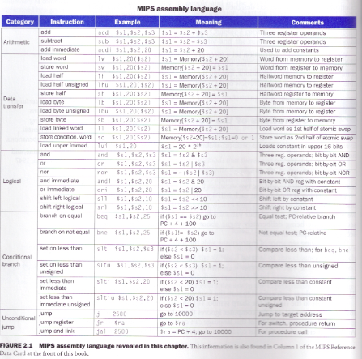
MIPS Instruction Set

